Slide 1


FAN
ENGAGEMENT
NBA
TWEETS

Slide 2

SETUP & GOALS
GOALS:
Analysis of the commentaries
Looking at our main Athletes / Competence
Main words related to the NBA
Provide useful insights on how to allocate the resources
SETUP :
Focus on Oct – Dec 2019
Sample of the data
Cleaned data
SETUP & GOALS
PLAYERS ANALYSIS
GENERAL ANALYSIS
FREQUENCY
DENDOGRAM
WORD CLOUD
CONCLUSION
APPENDIX

Slide 3

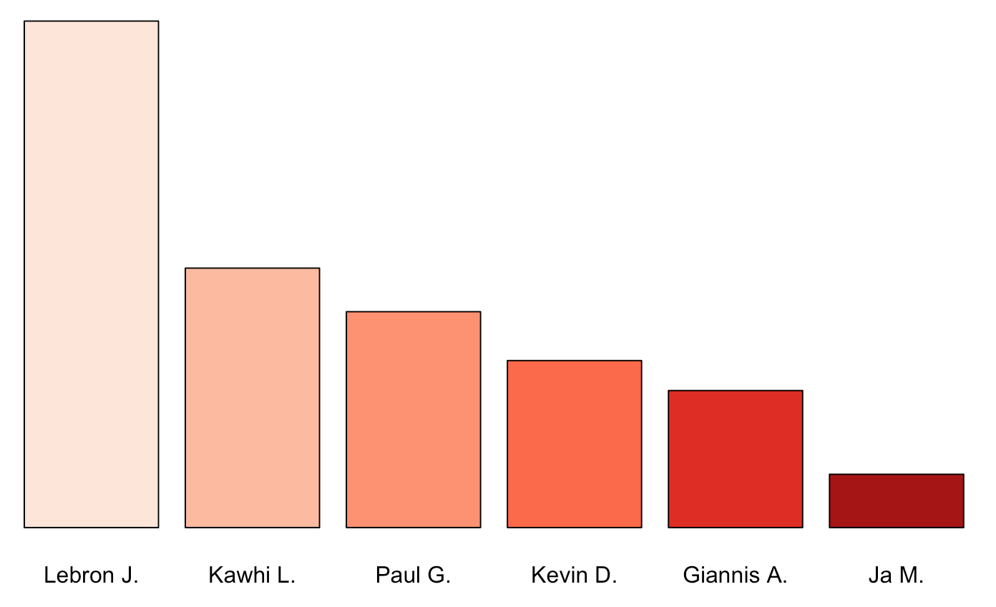
PLAYERS ANALYSIS
NIKE
SETUP & GOALS
PLAYERS ANALYSIS
GENERAL ANALYSIS
FREQUENCY
DENDOGRAM
WORD CLOUD
CONCLUSION
APPENDIX

Slide 4
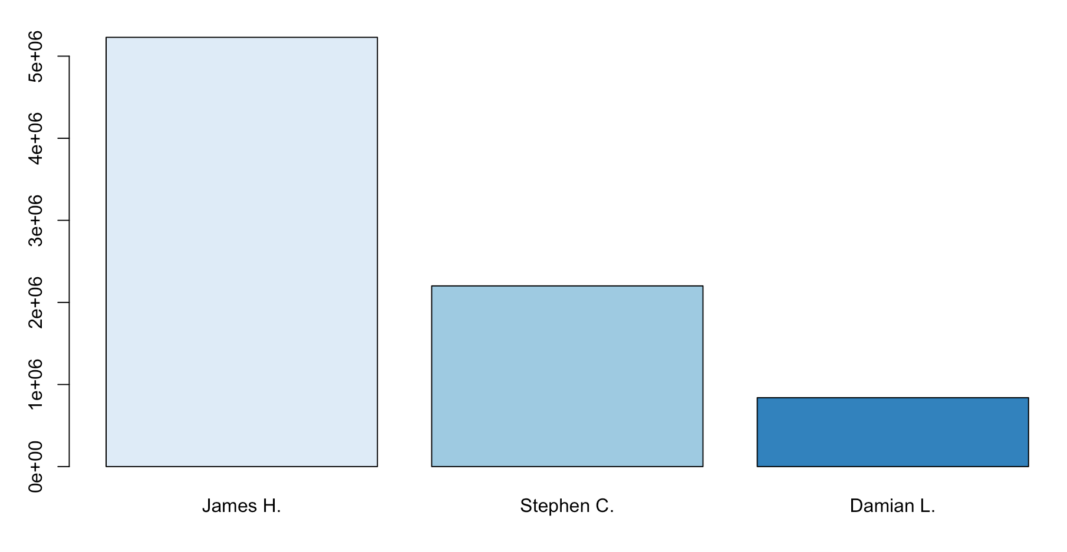
PLAYERS ANALYSIS
ADIDAS
SETUP & GOALS
PLAYERS ANALYSIS
GENERAL ANALYSIS
FREQUENCY
DENDOGRAM
WORD CLOUD
CONCLUSION
APPENDIX

Slide 5
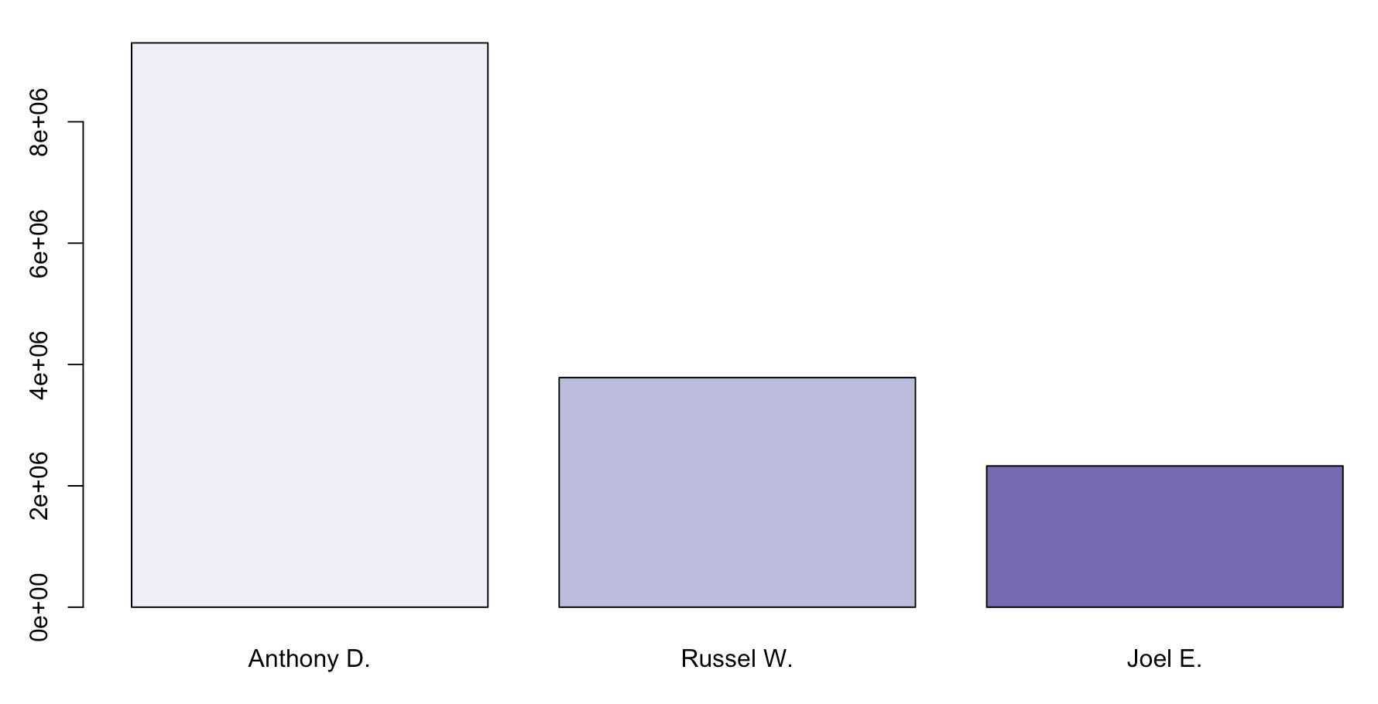
PLAYERS ANALYSIS
POTENTIAL PLAYERS WITHOUT SHOE DEAL
SETUP & GOALS
PLAYERS ANALYSIS
GENERAL ANALYSIS
FREQUENCY
DENDOGRAM
WORD CLOUD
CONCLUSION
APPENDIX

Slide 6
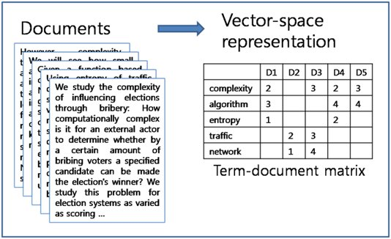
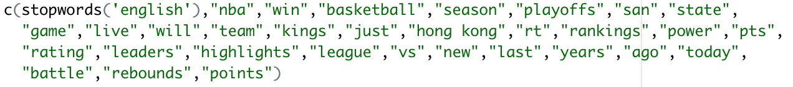
WORDS ANALYSIS
TDM :
Term Document Matrix
STOPWORDS :
SETUP & GOALS
PLAYERS ANALYSIS
GENERAL ANALYSIS
FREQUENCY
DENDOGRAM
WORD CLOUD
CONCLUSION
APPENDIX

Slide 7
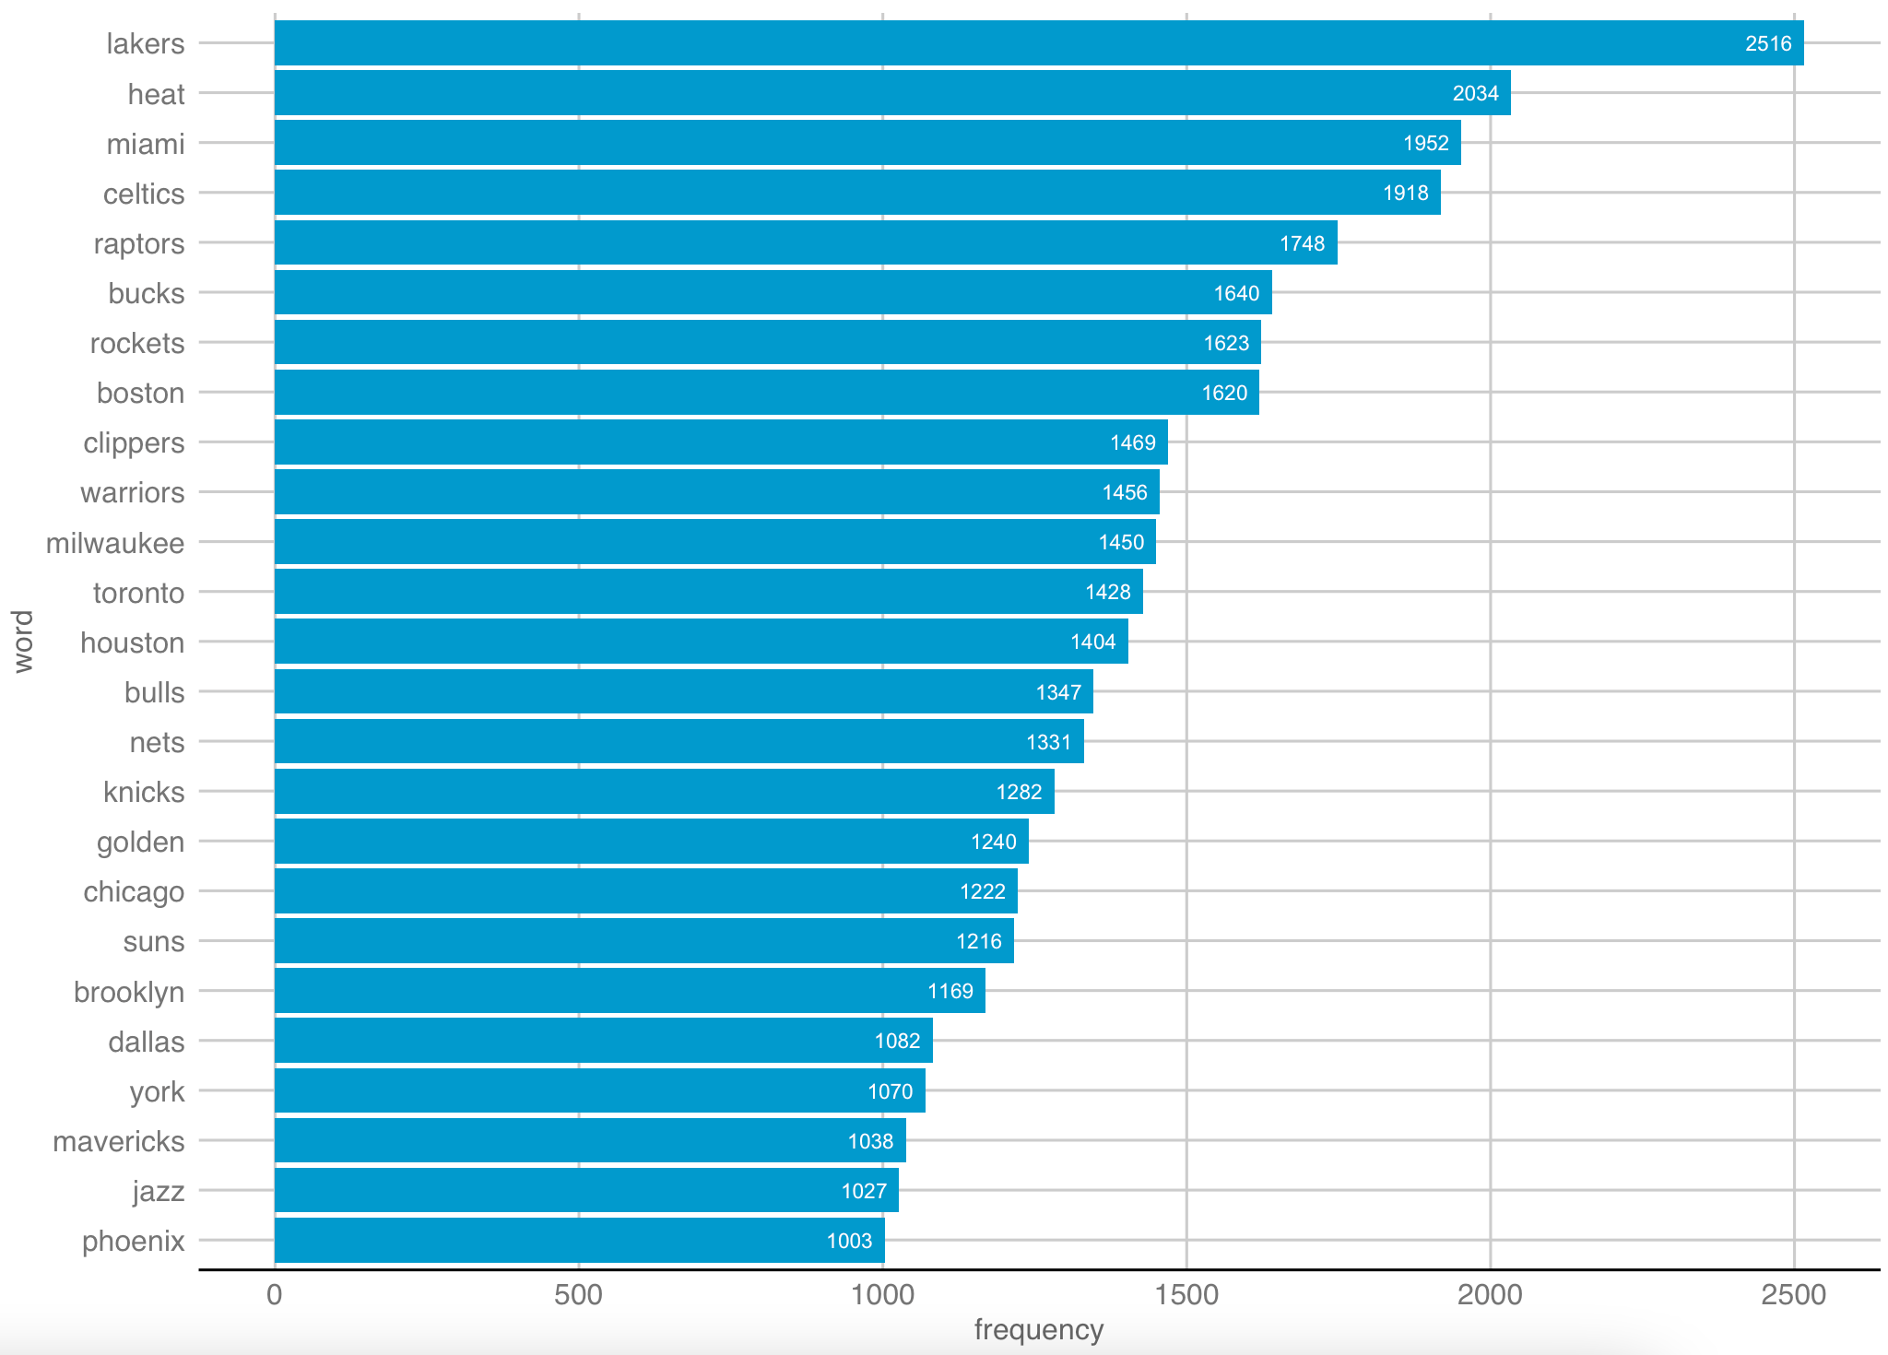
FREQUENCY
One word
SETUP & GOALS
PLAYERS ANALYSIS
GENERAL ANALYSIS
FREQUENCY
DENDOGRAM
WORD CLOUD
CONCLUSION
APPENDIX

Slide 8
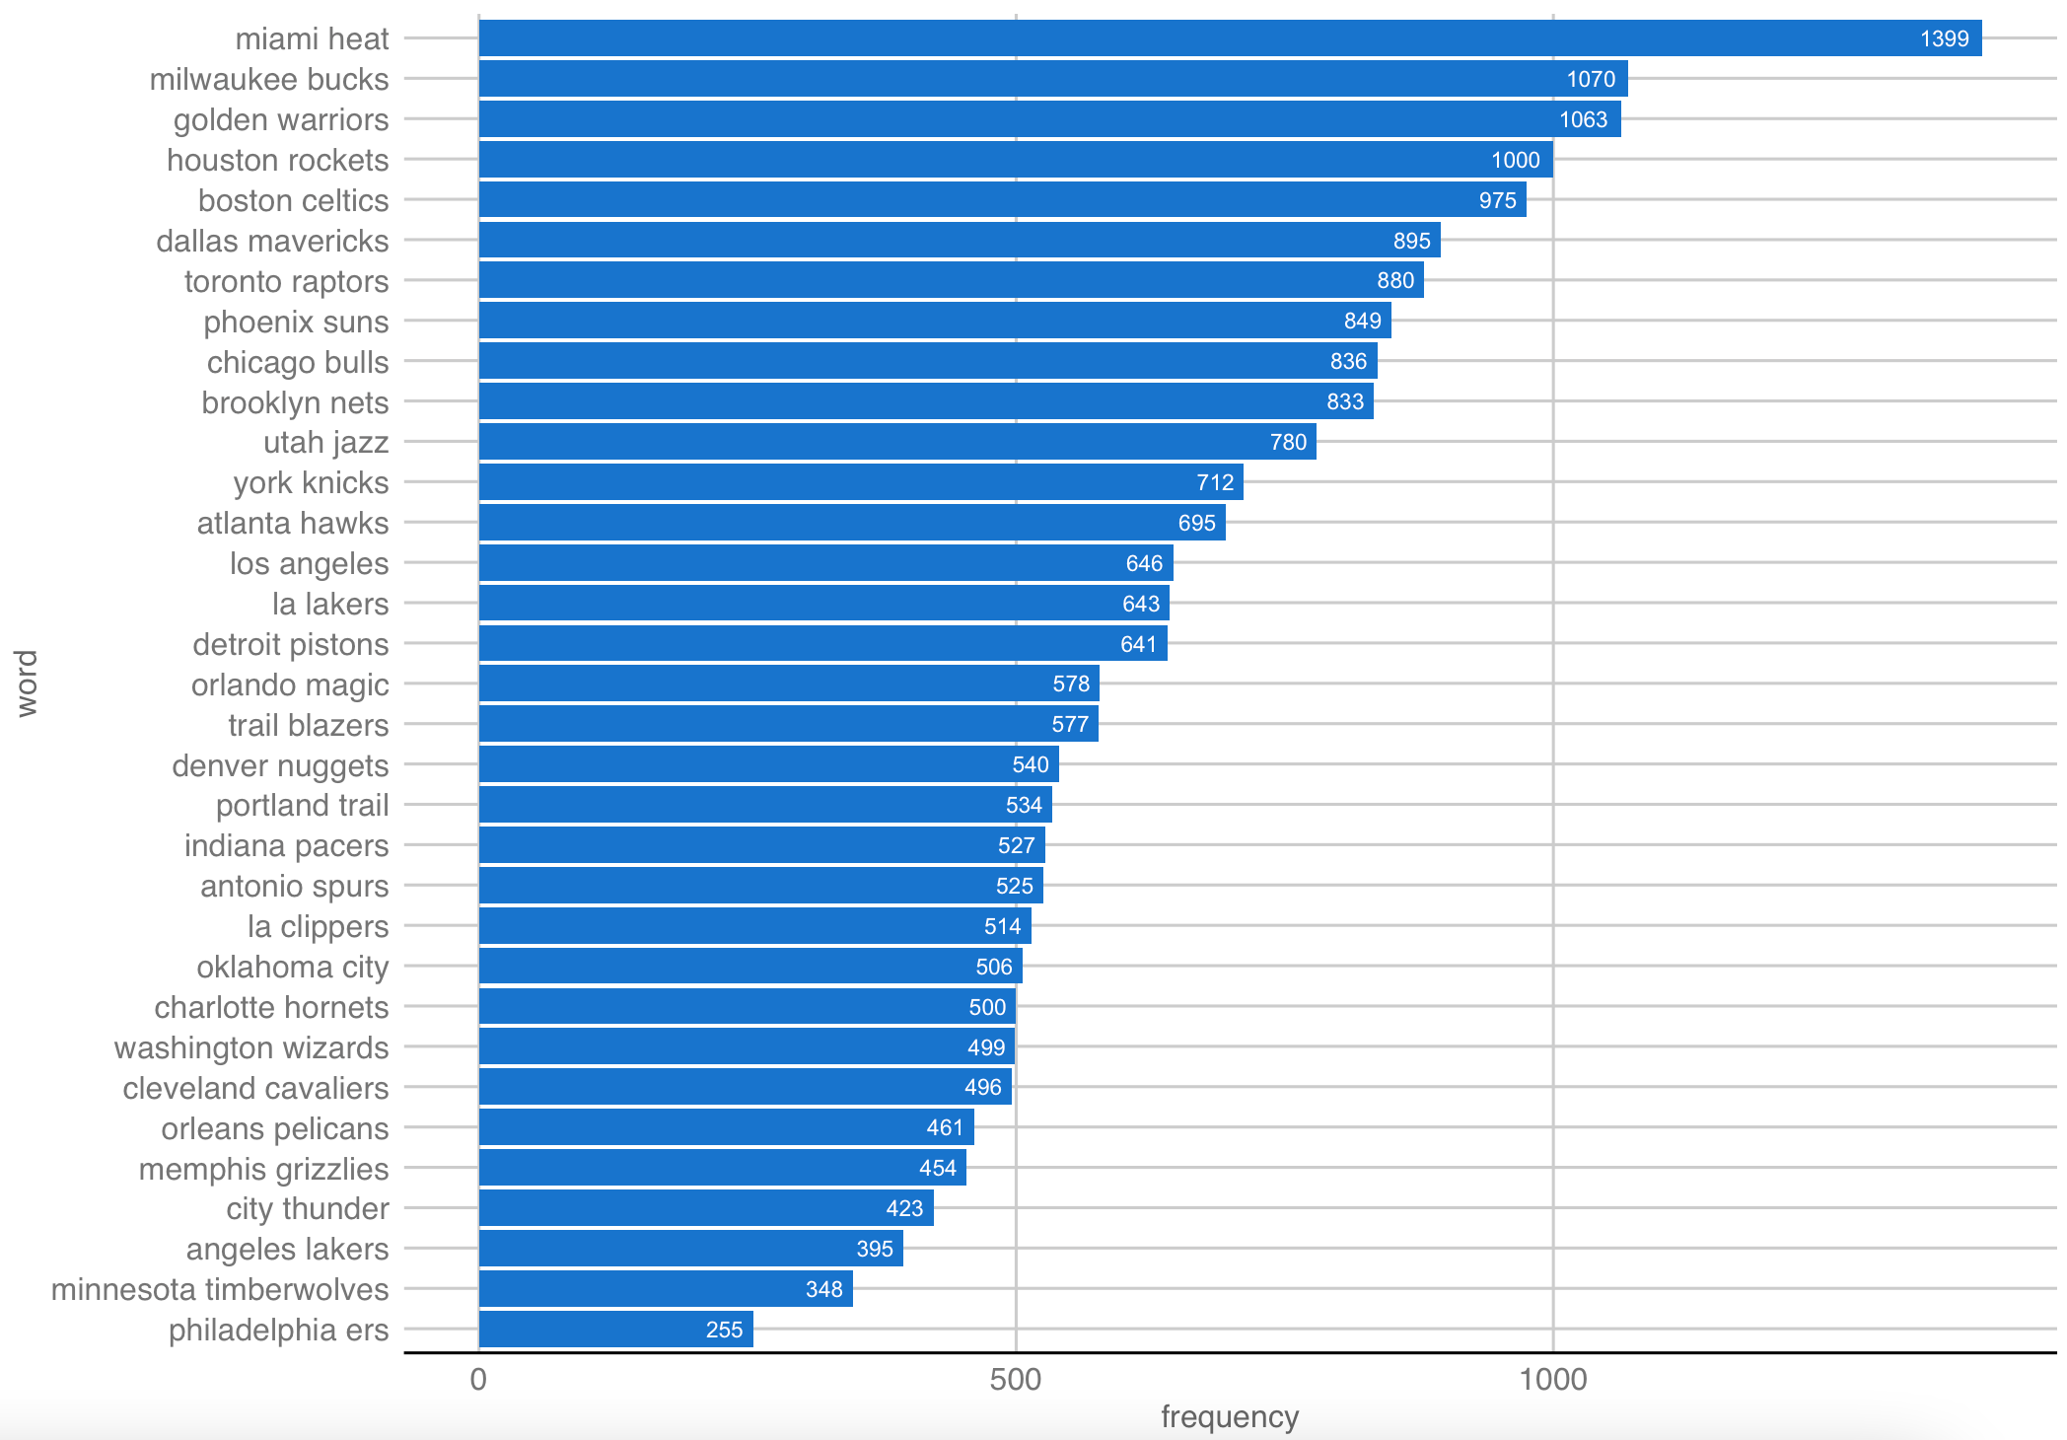
FREQUENCY
Two word
SETUP & GOALS
PLAYERS ANALYSIS
GENERAL ANALYSIS
FREQUENCY
DENDOGRAM
WORD CLOUD
CONCLUSION
APPENDIX

Slide 9
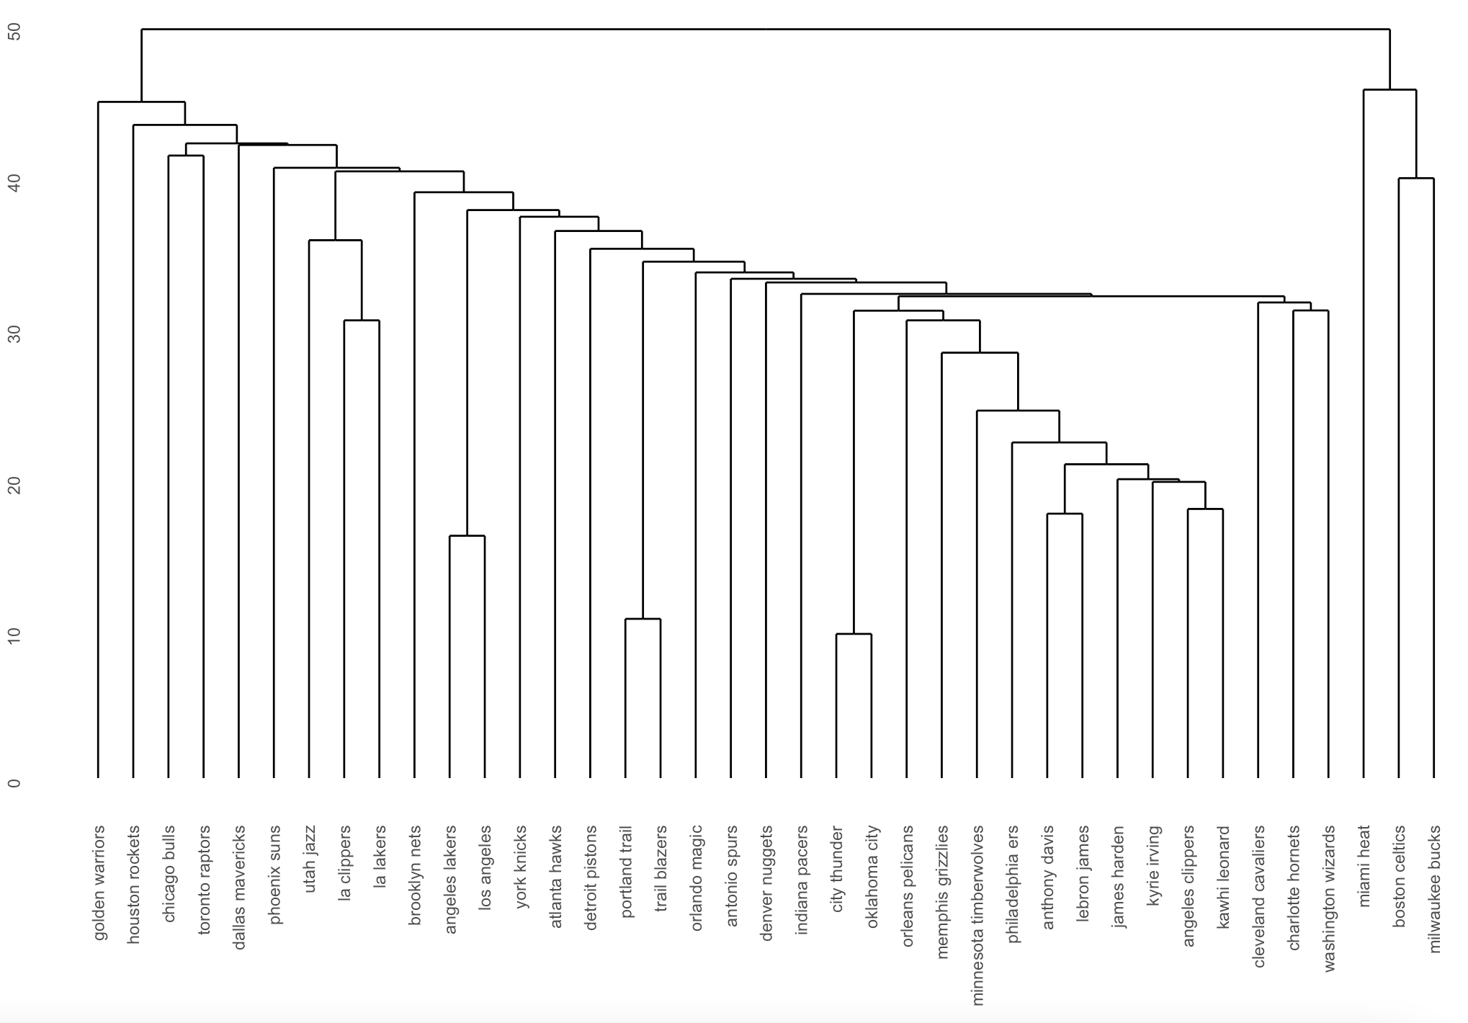
DENDOGRAM
SETUP & GOALS
PLAYERS ANALYSIS
GENERAL ANALYSIS
FREQUENCY
DENDOGRAM
WORD CLOUD
CONCLUSION
APPENDIX

Slide 10
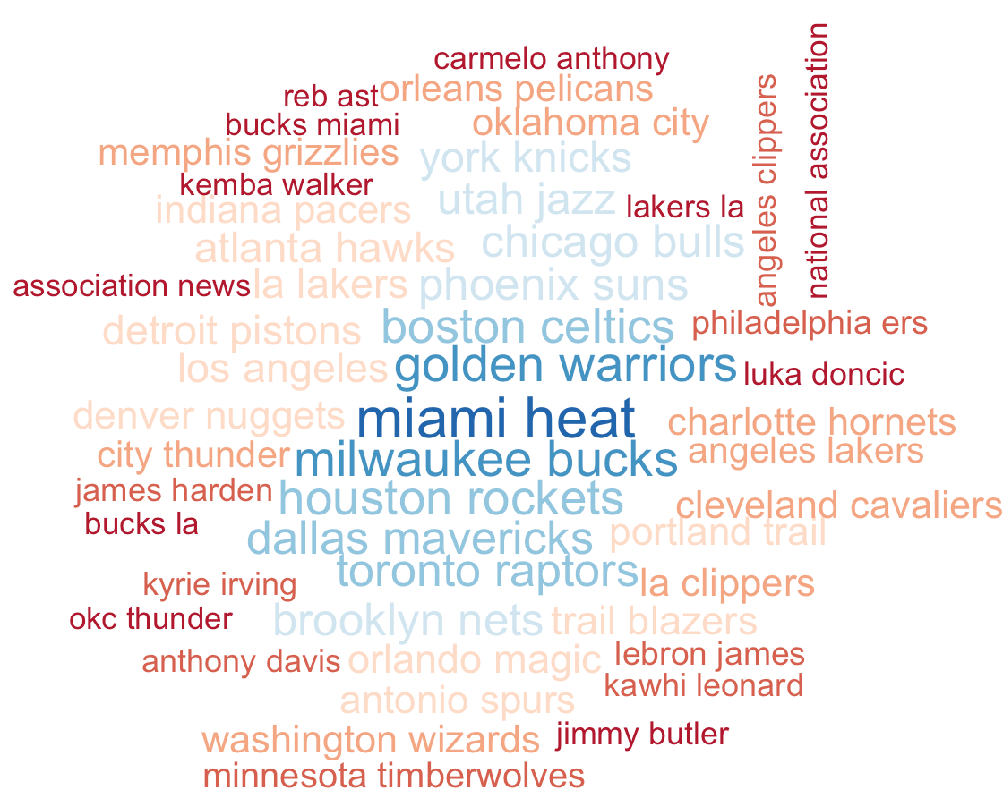
WORD CLOUD
SETUP & GOALS
PLAYERS ANALYSIS
GENERAL ANALYSIS
FREQUENCY
DENDOGRAM
WORD CLOUD
CONCLUSION
APPENDIX

Slide 11
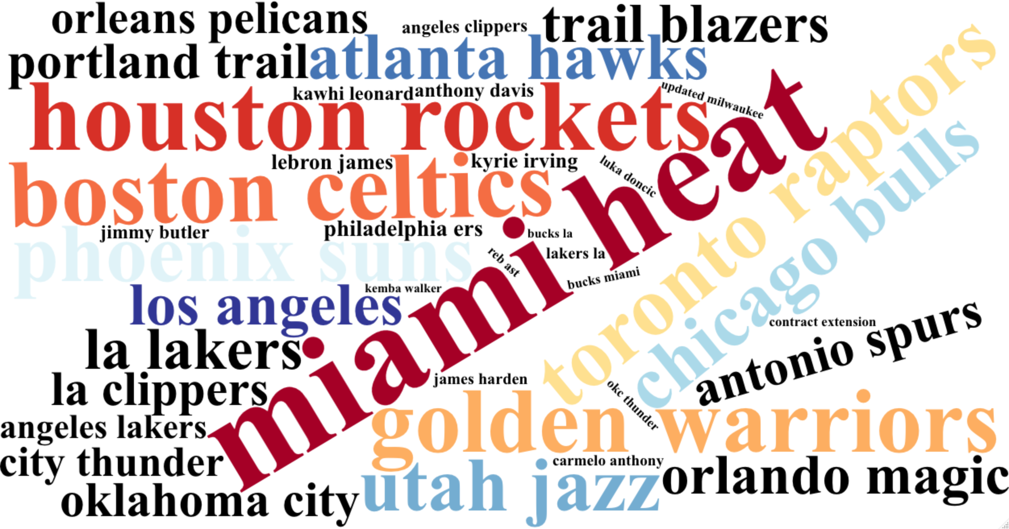
WORD CLOUD
SETUP & GOALS
PLAYERS ANALYSIS
GENERAL ANALYSIS
FREQUENCY
DENDOGRAM
WORD CLOUD
CONCLUSION
APPENDIX

Slide 12
CONCLUSIONS
Maintain the good promotion given by Lebron James
Try to give more attention to the rest of the players we have a contract with.
Consider the possibility of emerging players.
Focus on the teams that are doing the best
SETUP & GOALS
PLAYERS ANALYSIS
GENERAL ANALYSIS
FREQUENCY
DENDOGRAM
WORD CLOUD
CONCLUSION
APPENDIX

Slide 13
END

Slide 14
APPENDIX
LINKS :
https://bolavip.com/en/nba/lakers-vs-wizards-2021-22-nba-season-how-to-watch-predictions-and-odds-20220310-0014.html
https://www.basketball-reference.com/leagues/NBA_2020_leaders.html
https://www.basketball-reference.com/leagues/NBA_2019_leaders.html
https://www.cbssports.com/nba/news/top-100-nba-players-for-2018-19-lebron-james-headlines-rankings-front-loaded-with-west-superstars/
SETUP & GOALS
PLAYERS ANALYSIS
GENERAL ANALYSIS
FREQUENCY
DENDOGRAM
WORD CLOUD
CONCLUSION
APPENDIX

